Slide 1
import pandas as pd
BAAMEUR/WITT

Slide 2
comment_code_data2 analysis
2941629 lines in file, 2936485 line read in: loss of 5144
DecodeError
json format
other errors were ignored
Languages (langdetect)
based on comments
86% english
1.73% unknown
1.574 french
We DID NOT remove foreign languages from analysis

Slide 3
Comment Cleaning/Analysis
comments were stripped of all characters except for numbers, letters, and ‘@’
comments converted to lowercase
checked for word frequency
generally
w/ out stopwords (commonly occurring words in everyday speech like the, a, an etc.)
among keywords
java keywords we found online
Javadoc @XXXXX words that were found in general word frequency analysis
["@param", "@return", "@code", "@link", "@see", "@throw", "@exception"]
@param appeared in 63.8% of comments
@return in 33% of comments
checked for phrase frequency in for of tigrams/digrams

Slide 4
Smaller Data Visuals

Slide 5
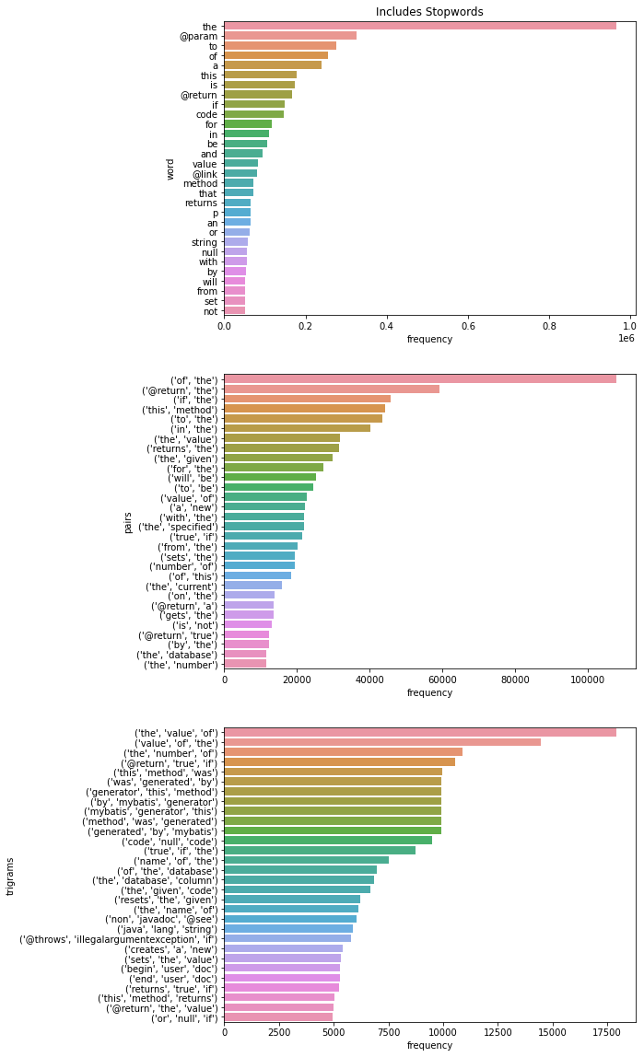

Slide 6
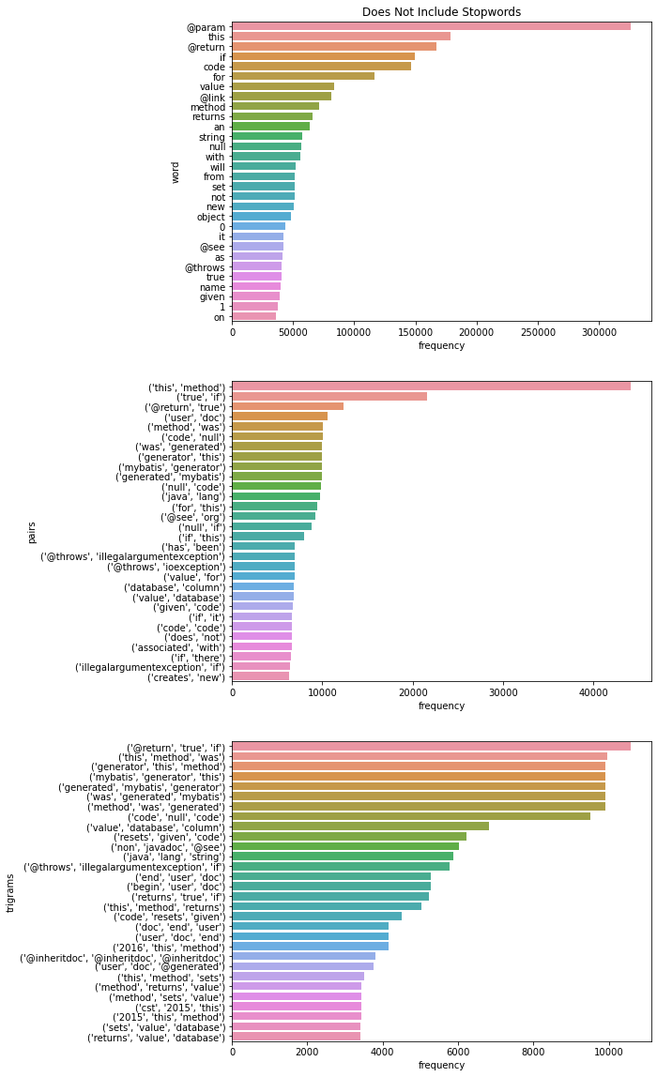

Slide 7
Full Data Visuals

Slide 8
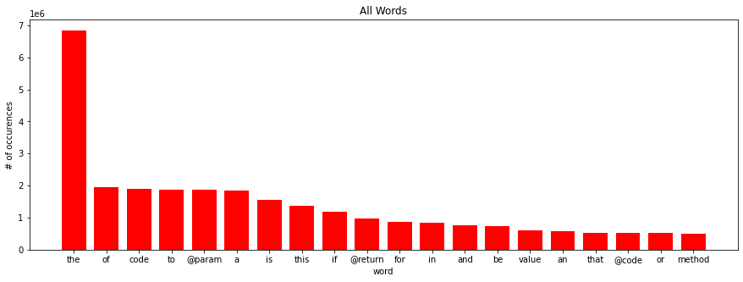
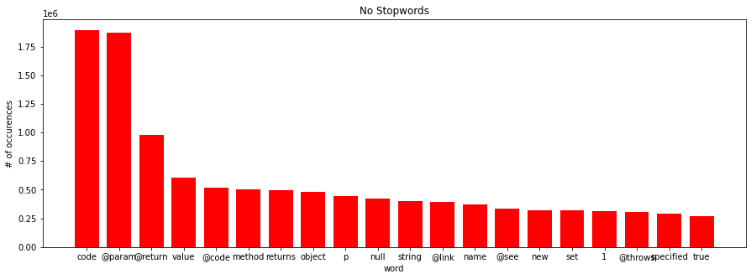

Slide 9
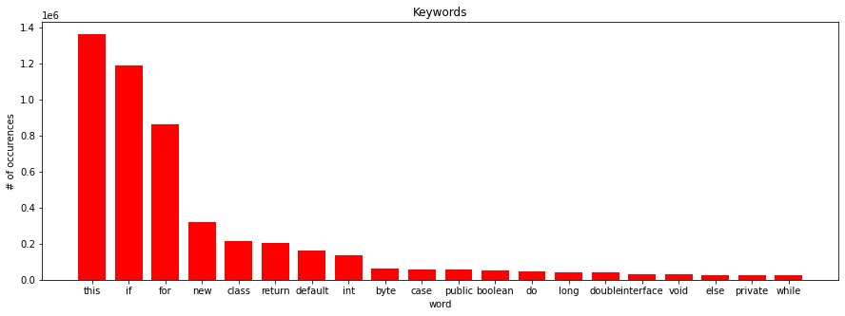
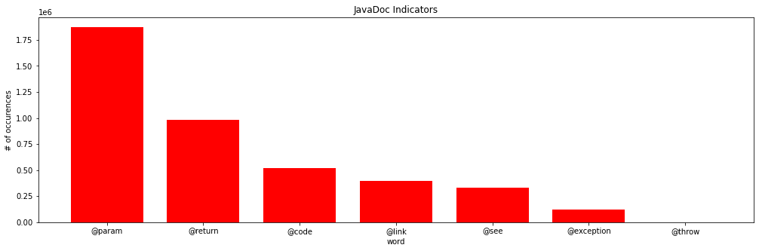

Slide 10
Code/Comment Attribute Specification
decided to look at certain code/comment characteristics to determine pair strength
code: only looked at function header
function type
number of parameters
list of parameter names
comments: decided to judge primarily by adherence to JavaDocs
comment header length
words after @XXXX word
number of @params
number of @returns
total number of @XXXXX (not really used)

Slide 11
Comment Strength Determination
Determined comment strength based on 4 areas with specific weights for a max score of 10
header length (weight=3): how long the header in comment is considering max score comes from length of 25, header_length/25(max of 1)*weight
number of parameter matches (weight=2): number of parameters in function matches the number of @params’s in the comments, calculated with params_in_function/@param_in_comment*weight with the smaller value in the numerator

Slide 12
Comment Strength Determination Cont’d
length of @XXXXX description(weight=3): number of words that are describing certain @XXXXX words with max score of 6 words after, calculated by words_after_@XXXX/6(max of 1)*weight
@return match (weight=2): checks if the function type is void, if it is void then there should not be an @return word and vise versa, boolean value
Weights and max score can be changed as function arguments
comment_eval(comment,code,head_weight,param_match_weight,return_match_weight,len_des

Slide 13
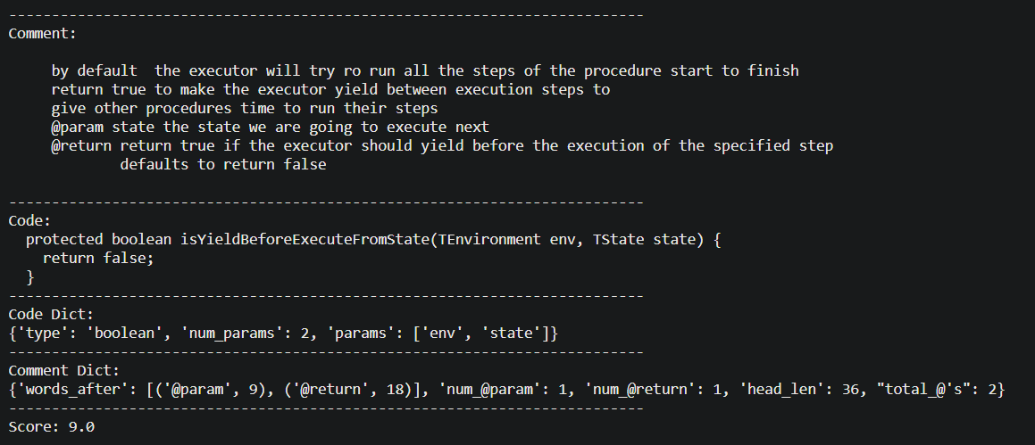
Example

Slide 14
Comment Strength Analysis

Slide 15
Small Dataset
Large Dataset
Scores between 0-0.99: 39976 (~8%)
Scores between 1-1.99: 24387 (~5%)
Scores between 2-2.99: 86856 (~17%)
Scores between 3-3.99: 63258 (~13%)
Scores between 4-4.99: 57116 (~12%)
Scores between 5-5.99: 74963 (~15%)
Scores between 6-6.99: 46748 (~10%)
Scores between 7-7.99: 51147 (~10%)
Scores between 8-8.99: 28707 (~6%)
Scores between 9-10.0: 20653 (~4%)
Scores between 0-0.99: 251315 (~9%)
Scores between 1-1.99: 157320 (~5%)
Scores between 2-2.99: 447809 (~15%)
Scores between 3-3.99: 358562 (~13%)
Scores between 4-4.99: 325411 (~12%)
Scores between 5-5.99: 416551 (~15%)
Scores between 6-6.99: 302670 (~10%)
Scores between 7-7.99: 305852 (~10%)
Scores between 8-8.99: 185114 (~6%)
Scores between 9-10.0: 148931 (~5%)

Slide 16
